Slide 1
Progress Report National Brain Councils
EBC General Assembly
Brussels, 7th February 2019

Slide 2
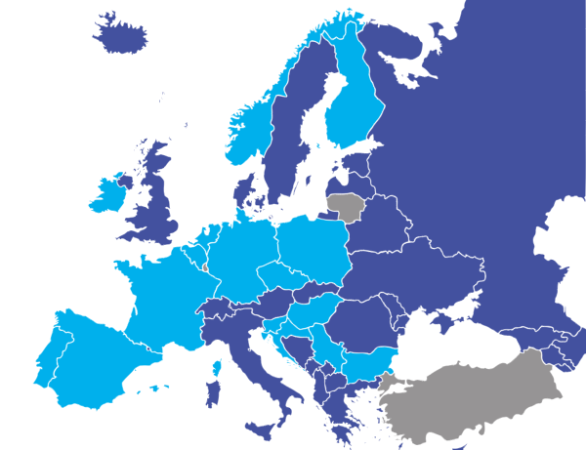
9 NBCs and 11 NAGs

Slide 3
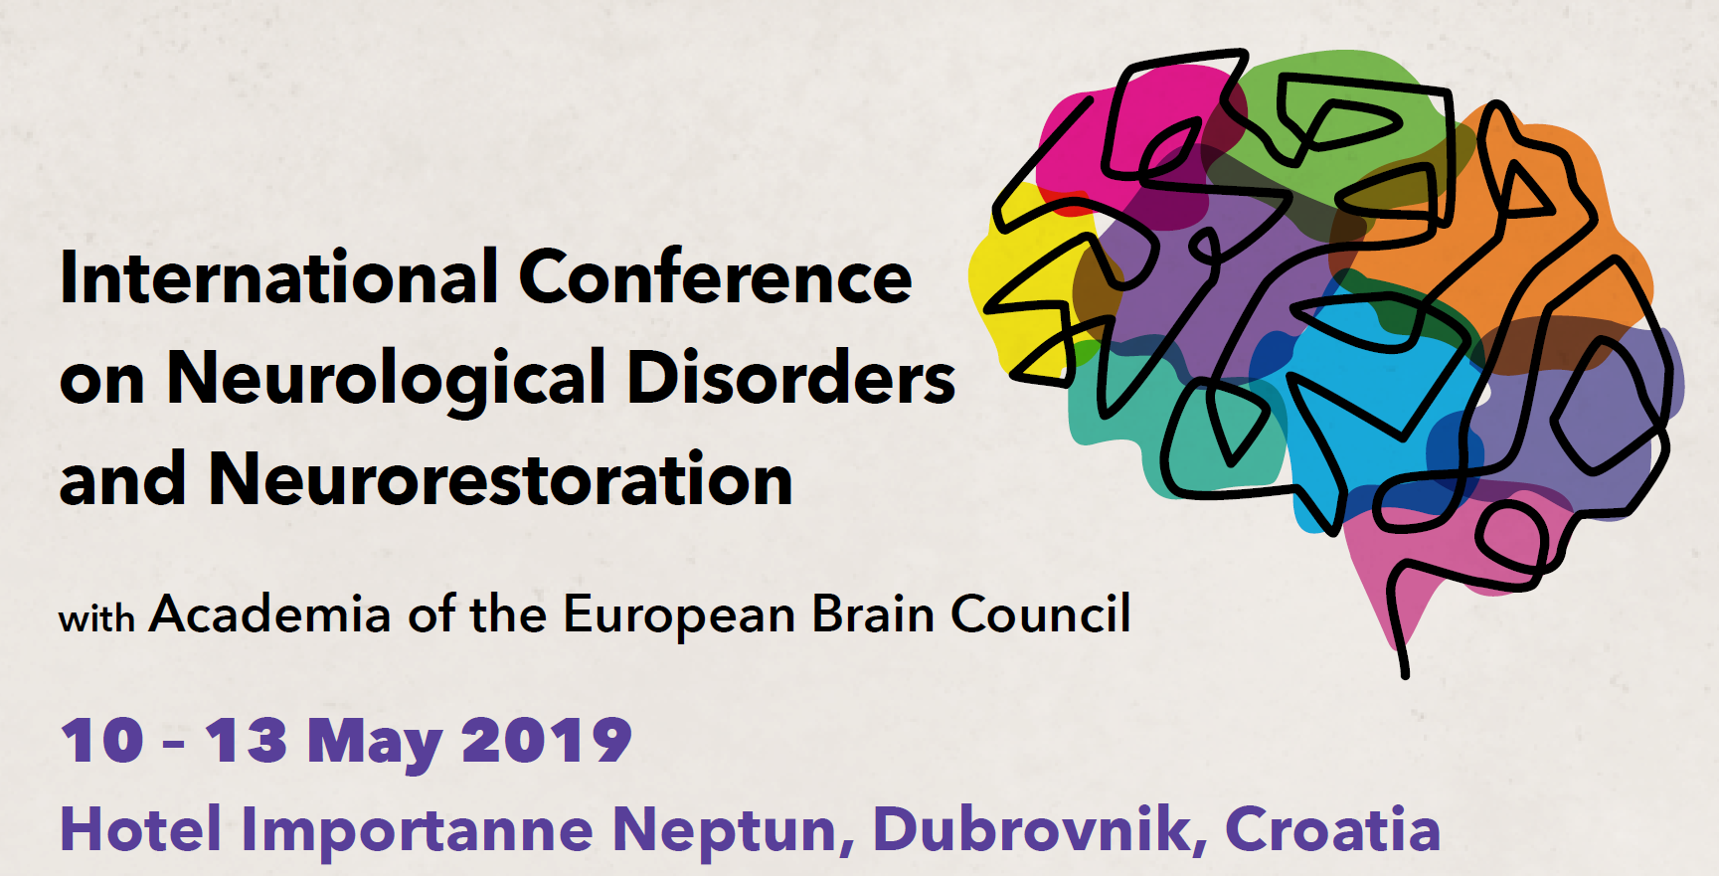
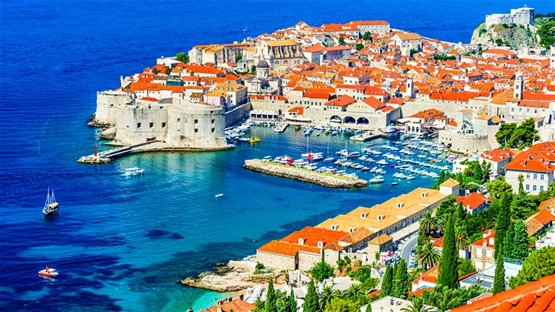
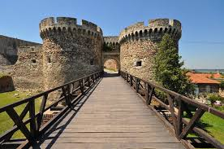
NBCs Academy and Regional Meeting
5th NBCs Academy
9-10 May 2019, Dubrovnik
NBCs & NAGs
Hosted by Prof. Dinko Mitrečić, Croatian Brain Council
http://www.neurology-neurorestoration-dubrovnik2019.com/
Regional meeting Belgrade
10 July 2019, prior to the FENS Regional Meeting
Hosted by Serbian Brain Council
Focus on cooperation in the region and common challenges faced by NBCs
Survey on joint challenges in the region (Austria, Croatia, Greece, Hungary, Serbia, Turkey...)

Slide 4
Horizon Europe “Call for Feedback”
Launched by the European Commission over summer
11 NBCs and neuroscientific societies responded to the call for feedback
Belgium, Bulgaria, Croatia, France, Germany, Greece, Hungary, Poland, Serbia, Spain and Turkey
8 NBCs and 1 neuroscience group wrote to national governments afterwards
Belgium, Croatia, France, Germany, Greece, Poland, Portugal Serbia and Spain

Slide 5
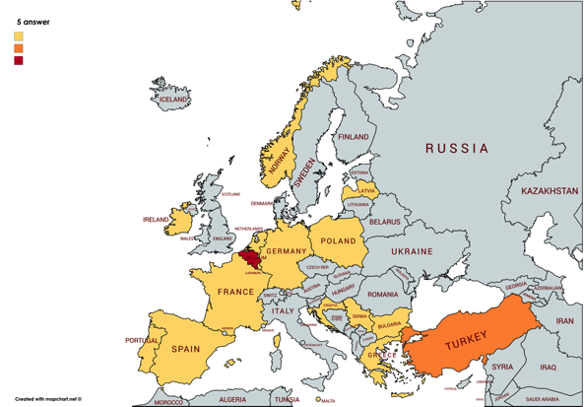
Survey and list of priorities
17 countries
10 Priorities for National Brain Plans
<EU-OECD report : HEALTH at a GLANCE : EUROPE>

Slide 6
Recurring calls with NBCs
Allow for exchange of views on joint initiatives and sharing of best practices
Chaired by 4 NBCs Coordinators
Prof. Roland Pochet (Belgian Brain Council)
Prof. Pavle Andjus (Serbian Brain Council)
Prof. François Mauguière (French Brain Council)
Dr. José Luis Trejo (Spanish Brain Council)
Calls held on 19th September and 10th December 2018
Next call during the week of 25th February 2019

Slide 7
Future activities, Recommendations & Strategy for NBCs
Disseminate the 10 priorities published
Implement NBC Award (search for sponsors)
Increase bottom-up approach (NBCs vs EBC)
Increase national patients associations involvement
Increase interactions between national Members of Parliament and European Members of the Parliament

